Slide 1
MODULE -3
Statistical Experiments and Significance Testing
BY Sunil Naidu G R

Slide 2
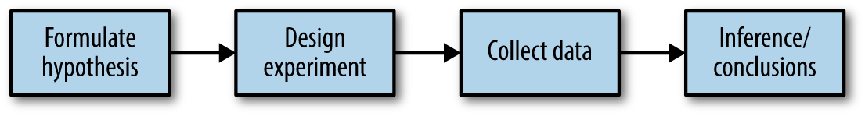
Whenever you see references to statistical significance, t-tests, or p-values, it is typically in the context of the classical statistical inference “pipeline. This process starts with a hypothesis (“drug A is better than the existing standard drug,” or “price A is more profitable than the existing price B”). An experiment (it might be an A/B test) is designed to test the hypothesis—designed in such a way that it hopefully will deliver conclusive results. The data is collected and analyzed, and then a conclusion is drawn. The term inference reflects the intention to apply the experiment results, which involve a limited set of data, to a larger process or population.

Slide 3
A/B Testing
An A/B test is an experiment with two groups to establish which of two treatments, products, procedures, or the like is superior. Often one of the two treatments is the standard existing treatment, or no treatment. If a standard (or no) treatment is used, it is called the control. A typical hypothesis is that a new treatment is better than the control.
Key Terms for A/B Testing
Treatment
Something (drug, price, web headline) to which a subject is exposed.
Treatment group
A group of subjects exposed to a specific treatment.
Control group
A group of subjects exposed to no (or standard) treatment.
Randomization
The process of randomly assigning subjects to treatments.
Subjects
The items (web visitors, patients, etc.) that are exposed to treatments.
Test statistic
The metric used to measure the effect of the treatment.

Slide 4

A/B tests are common in web design and marketing, since results are so readily measured.
Some examples of A/B testing include:
• Testing two soil treatments to determine which produces better seed germination
• Testing two therapies to determine which suppresses cancer more effectively
• Testing two prices to determine which yields more net profit
• Testing two web headlines to determine which produces more clicks (Figure 3-2)
• Testing two web ads to determine which generates more conversions
Figure 3-2. Marketers continually test one web presentation against another

Slide 5
A/B testing in data science is typically used in a web context. Treatments might be the design of a web page, the price of a product, the wording of a headline, or some other item. Some thought is required to preserve the principles of randomization. Typically the subject in the experiment is the web visitor, and the outcomes we are interested in measuring are clicks, purchases, visit duration, number of pages visited, whether a particular page is visited, and the like. In a standard A/B experiment, you need to decide on one metric ahead of time. Multiple behavior metrics might be collected and be of interest, but if the experiment is expected to lead to a decision between treatment A and treatment B, a single metric, or test statistic, needs to be established beforehand. Selecting a test statistic after the experiment is conducted opens the door to researcher bias.
Why Just A/B? Why Not C, D,…?
A/B tests are popular in the marketing and ecommerce worlds, but are far from the only type of statistical experiment. Additional treatments can be included. Subjects might have repeated measurements taken. Pharmaceutical trials where subjects are scarce, expensive, and acquired over time are sometimes designed with multiple opportunities to stop the experiment and reach a conclusion.

Slide 6
You also need to pay attention to the test statistic or metric you use to compare group A to group B. Perhaps the most common metric in data science is a binary variable: click or no-click, buy or don’t buy, fraud or no fraud, and so on. Those results would be summed up in a 2×2 table. Table 3-1 is a 2×2 table for an actual price test (see “Statistical Significance and p-Values” on page 103 for further discussion of these results).
Table 2×2 table for ecommerce experiment results
Outcome Price A Price B
Conversion 200 182
No conversion 23,539 22,406
If the metric is a continuous variable (purchase amount, profit, etc.) or a count (e.g., days in hospital, pages visited), the result might be displayed differently. If one were interested not in conversion but in revenue per page view, the results of the price test in Table above might look like this in typical default software output:
Revenue/page view with price A: mean = 3.87, SD = 51.10
Revenue/page view with price B: mean = 4.11, SD = 62.98
The method scipy.stats.chi2_contingency takes the values as shown in Table 3-2:
survivors = np.array([[200, 23739 - 200], [182, 22588 - 182]])
chi2, p_value, df, _ = stats.chi2_contingency(survivors)
print(f'p-value for single sided test: {p_value / 2:.4f}')

Slide 7
Hypothesis Tests
Hypothesis tests, also called significance tests, are ubiquitous in the traditional statistical
analysis of published research. Their purpose is to help you learn whether random chance might be responsible for an observed effect.
Key Terms for Hypothesis Tests
Null hypothesis
The hypothesis that chance is to blame.
Alternative hypothesis
Counterpoint to the null (what you hope to prove).
One-way test
Hypothesis test that counts chance results only in one direction.
Two-way test
Hypothesis test that counts chance results in two directions.

Slide 8
The Null Hypothesis
Hypothesis tests use the following logic: “Given the human tendency to react to unusual but random behavior and interpret it as something meaningful and real, in our experiments we will require proof that the difference between groups is more extreme than what chance might reasonably produce.” This involves a baseline assumption that the treatments are equivalent, and any difference between the groups is due to chance. This baseline assumption is termed the null hypothesis. Our hope, then, is that we can in fact prove the null hypothesis wrong and show that the outcomes for groups A and B are more different than what chance might produce.
One way to do this is via a resampling permutation procedure, in which we shuffle together the results from groups A and B and then repeatedly deal out the data in groups of similar sizes, and then observe how often we get a difference as extreme as the observed difference. The combined shuffled results from groups A and B, and the procedure of resampling from them, embodies the null hypothesis of groups A and B being equivalent and interchangeable and is termed the null model

Slide 9
Alternative Hypothesis
Hypothesis tests by their nature involve not just a null hypothesis but also an offsetting alternative hypothesis. Here are some examples:
• Null = “no difference between the means of group A and group B”; alternative =
“A is different from B” (could be bigger or smaller)
• Null = “A ≤ B”; alternative = “A > B”
• Null = “B is not X% greater than A”; alternative = “B is X% greater than A”
Taken together, the null and alternative hypotheses must account for all possibilities.
The nature of the null hypothesis determines the structure of the hypothesis test.

Slide 10
One-Way Versus Two-Way Hypothesis Tests
Often in an A/B test, you are testing a new option (say, B) against an established default option (A), and the presumption is that you will stick with the default option unless the new option proves itself definitively better. In such a case, you want a hypothesis test to protect you from being fooled by chance in the direction favoring B. You don’t care about being fooled by chance in the other direction, because you would be sticking with A unless B proves definitively better. So you want a directional alternative hypothesis (B is better than A). In such a case, you use a one-way (or one-tail) hypothesis test. This means that extreme chance results in only one direction count toward the p-value.
If you want a hypothesis test to protect you from being fooled by chance in either direction, the alternative hypothesis is bidirectional (A is different from B; could be bigger or smaller). In such a case, you use a two-way (or two-tail) hypothesis. This means that extreme chance results in either direction count toward the p-value.

Slide 11
Key Terms for Resampling
Permutation test
The procedure of combining two or more samples together and randomly (or exhaustively) reallocating the observations to resamples.
Synonyms
Randomization test, random permutation test, exact test
Resampling
Drawing additional samples (“resamples”) from an observed data set.
With or without replacement In sampling, whether or not an item is returned to the sample before the next draw.

Slide 12
Permutation Test
In a permutation procedure, two or more samples are involved, typically the groups in an A/B or other hypothesis test. Permute means to change the order of a set of values.
The first step in a permutation test of a hypothesis is to combine the results from groups A and B (and, if used, C, D,…). This is the logical embodiment of the null hypothesis that the treatments to which the groups were exposed do not differ. We then test that hypothesis by randomly drawing groups from this combined set and seeing how much they differ from one another. The permutation procedure is as follows:
1. Combine the results from the different groups into a single data set.
2. Shuffle the combined data and then randomly draw (without replacement) a
resample of the same size as group A (clearly it will contain some data from the other groups).
3. From the remaining data, randomly draw (without replacement) a resample of the same size as group B.
4. Do the same for groups C, D, and so on. You have now collected one set of resamples that mirror the sizes of the original samples.
5. Whatever statistic or estimate was calculated for the original samples (e.g., difference in group proportions), calculate it now for the resamples, and record; this constitutes one permutation iteration.
6. Repeat the previous steps R times to yield a permutation distribution of the test
statistic.

Slide 13
Example: Web Stickiness
A company selling a relatively high-value service wants to test which of two web presentations does a better selling job. Due to the high value of the service being sold, sales are infrequent and the sales cycle is lengthy; it would take too long to accumulate enough sales to know which presentation is superior. So the company decides to measure the results with a proxy variable, using the detailed interior page that describes the service.
One potential proxy variable for our company is the number of clicks on the detailed landing page. A better one is how long people spend on the page. It is reasonable to think that a web presentation (page) that holds people’s attention longer will lead to more sales. Hence, our metric is average session time, comparing page A to page B.
Due to the fact that this is an interior, special-purpose page, it does not receive a huge number of visitors. Also note that Google Analytics, which is how we measure session time, cannot measure session time for the last session a person visits. Instead of deleting that session from the data, though, Google Analytics records it as a zero, so the data requires additional processing to remove those sessions. The result is a total of 36 sessions for the two different presentations, 21 for page A and 15 for page B. Using ggplot, we can visually compare the session times using side-by-side boxplots:

Slide 14
ggplot(session_times, aes(x=Page, y=Time)) +
geom_boxplot()
The pandas boxplot command uses the keyword argument by to create the figure:
ax = session_times.boxplot(by='Page', column='Time')
ax.set_xlabel('')
ax.set_ylabel('Time (in seconds)')
plt.suptitle('')
In Python, we filter the pandas data frame first by page and then determine the mean of the Time column:
mean_a = session_times[session_times.Page == 'Page A'].Time.mean()
mean_b = session_times[session_times.Page == 'Page B'].Time.mean()
mean_b - mean_a

Slide 15
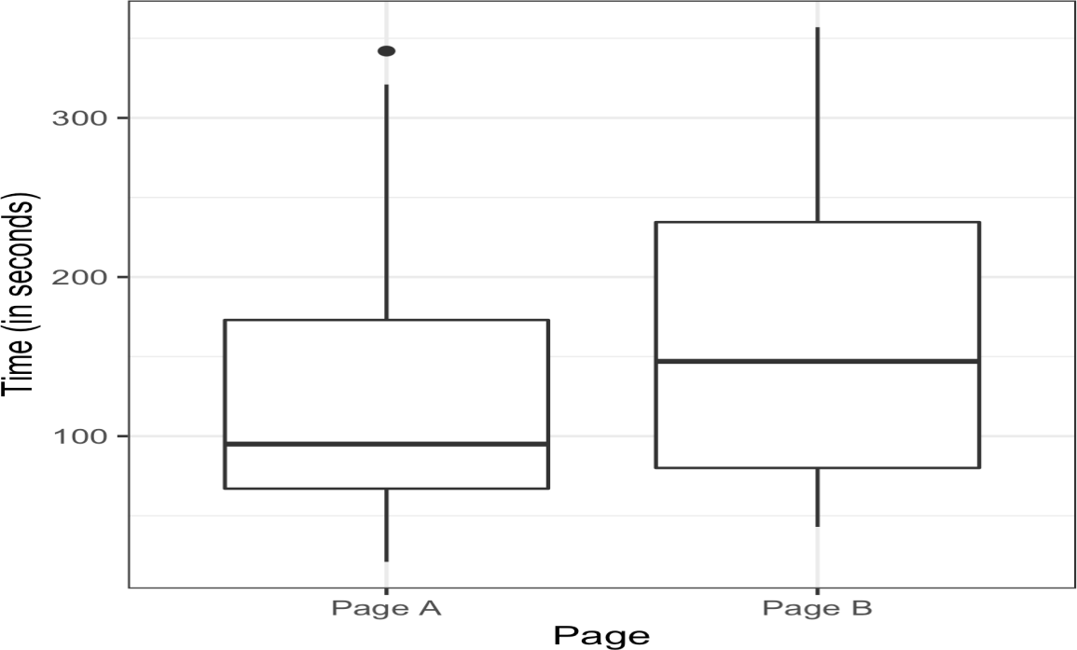
Page B has session times that are greater than those of page A by 35.67 seconds, on average. The question is whether this difference is within the range of what random chance might produce, i.e., is statistically significant. One way to answer this is to apply a permutation test—combine all the session times together and then repeatedly shuffle and divide them into groups of 21 (recall that nA = 21 for page A) and 15(nB = 15 for page B).
To apply a permutation test, we need a function to randomly assign the 36 session times to a group of 21 (page A) and a group of 15 (page B).
The Python version of this permutation test is the following:
def perm_fun(x, nA, nB):
n = nA + nB
idx_B = set(random.sample(range(n), nB))
idx_A = set(range(n)) - idx_B
return x.loc[idx_B].mean() - x.loc[idx_A].mean()
Figure 3-3. Session times for web pages A and B

Slide 16
This function works by sampling (without replacement) nB indices and assigning them to the B group; the remaining nA indices are assigned to group A. The difference between the two means is returned. Calling this function R = 1,000 times and specifying nA = 21 and nB = 15 leads to a distribution of differences in the session times that can be plotted as a histogram
In Python, we can create a similar graph using matplotlib:
perm_diffs = [perm_fun(session_times.Time, nA, nB) for _ in range(1000)]
fig, ax = plt.subplots(figsize=(5, 5))
ax.hist(perm_diffs, bins=11, rwidth=0.9)
ax.axvline(x = mean_b - mean_a, color='black', lw=2)
ax.text(50, 190, 'Observed\ndifference', bbox={'facecolor':'white'})
ax.set_xlabel('Session time differences (in seconds)')
ax.set_ylabel('Frequency')

Slide 17
Statistical Significance and p-Values
Statistical significance is how statisticians measure whether an experiment (or even a study of existing data) yields a result more extreme than what chance might produce.
If the result is beyond the realm of chance variation, it is said to be statistically significant.
Key Terms for Statistical Significance and p-Values
p-value
Given a chance model that embodies the null hypothesis, the p-value is the probability of obtaining results as unusual or extreme as the observed results.
Alpha
The probability threshold of “unusualness” that chance results must surpass for actual outcomes to be deemed statistically significant.
Type 1 error
Mistakenly concluding an effect is real (when it is due to chance).
Type 2 error
Mistakenly concluding an effect is due to chance (when it is real).

Slide 18
Alpha
Statisticians frown on the practice of leaving it to the researcher’s discretion to determine
whether a result is “too unusual” to happen by chance. Rather, a threshold is
specified in advance, as in “more extreme than 5% of the chance (null hypothesis)
results”; this threshold is known as alpha
Type 1 and Type 2 Errors
In assessing statistical significance, two types of error are possible:
• A Type 1 error, in which you mistakenly conclude an effect is real, when it is really just due to chance
• A Type 2 error, in which you mistakenly conclude that an effect is not real (i.e., due to chance), when it actually is real Actually, a Type 2 error is not so much an error as a judgment that the sample size is too small to detect the effect. When a p-value falls short of statistical significance
(e.g., it exceeds 5%), what we are really saying is “effect not proven.” It could be that a
larger sample would yield a smaller p-value.
The basic function of significance tests (also called hypothesis tests) is to protect
against being fooled by random chance; thus they are typically structured to minimize
Type 1 errors.

Slide 19
t-Tests
There are numerous types of significance tests, depending on whether the data comprises count data or measured data, how many samples there are, and what’s being measured. A very common one is the t-test, named after Student’s t-distribution, originally developed by W. S. Gosset to approximate the distribution of a single sample
mean.
Key Terms for t-Tests
Test statistic
A metric for the difference or effect of interest.
t-statistic
A standardized version of common test statistics such as means.
t-distribution
A reference distribution (in this case derived from the null hypothesis), to which the observed t-statistic can be compared.

Slide 20
In the 1920s and 1930s, when statistical hypothesis testing was being developed, it was not feasible to randomly shuffle data thousands of times to do a resampling test. Statisticians found that a good approximation to the permutation (shuffled) distribution was the t-test, based on Gosset’s t-distribution. It is used for the very common two-sample comparison—A/B test—in which the data is numeric. But in order for the t-distribution to be used without regard to scale, a standardized form of the test statistic must be used.
The function scipy.stats.ttest_ind can be used in Python:
res = stats.ttest_ind(session_times[session_times.Page == 'Page A'].Time,
session_times[session_times.Page == 'Page B'].Time,
equal_var=False)
print(f'p-value for single sided test: {res.pvalue / 2:.4f}')

Slide 21
P-values can indicate how incompatible the data are with a specified statistical model.
2. P-values do not measure the probability that the studied hypothesis is true, or the probability that the data were produced by random chance alone.
3. Scientific conclusions and business or policy decisions should not be based only on whether a p-value passes a specific threshold.
4. Proper inference requires full reporting and transparency.
5. A p-value, or statistical significance, does not measure the size of an effect or the importance of a result.
6. By itself, a p-value does not provide a good measure of evidence regarding a model or hypothesis.

Slide 22
Multiple Testing
As we’ve mentioned previously, there is a saying in statistics: “Torture the data long enough, and it will confess.” This means that if you look at the data through enough different perspectives and ask enough questions, you almost invariably will find a statistically significant effect.
For example, if you have 20 predictor variables and one outcome variable, all randomly generated, the odds are pretty good that at least one predictor will (falsely) turn out to be statistically significant if you do a series of 20 significance tests at the alpha = 0.05 level. As previously discussed, this is called a Type 1 error. You can calculate this probability by first finding the probability that all will correctly test nonsignificant at the 0.05 level. The probability that one will correctly test nonsignificant is 0.95, so the probability that all 20 will correctly test nonsignificant is 0.95 × 0.95 × 0.95…, or 0.9520 = 0.36.1 The probability that at least one predictor will (falsely) test significant is the flip side of this probability, or 1 – (probability that all will be nonsignificant) = 0.64. This is known as alpha inflation.

Slide 23
Key Terms for Multiple Testing
Type 1 error
Mistakenly concluding that an effect is statistically significant.
False discovery rate
Across multiple tests, the rate of making a Type 1 error.
Alpha inflation
The multiple testing phenomenon, in which alpha, the probability of making a Type 1 error, increases as you conduct more tests.
Adjustment of p-values
Accounting for doing multiple tests on the same data.
Overfitting
Fitting the noise.

Slide 24
In statistics, there are some procedures intended to deal with this problem in very specific circumstances. For example, if you are comparing results across multiple treatment groups, you might ask multiple questions. So, for treatments A–C, you might ask:
• Is A different from B?
• Is B different from C?
• Is A different from C?
• Checking for multiple pairwise differences across groups.
• Looking at multiple subgroup results (“we found no significant treatment effect overall, but we did find an effect for unmarried women younger than 30”).
• Trying lots of statistical models.
• Including lots of variables in models.
• Asking a number of different questions (i.e., different possible outcomes)

Slide 25
Degrees of Freedom
In the documentation and settings for many statistical tests and probability distributions, you will see a reference to “degrees of freedom.” The concept is applied to statistics calculated from sample data, and refers to the number of values free to vary. For example, if you know the mean for a sample of 10 values, there are 9 degrees of freedom (once you know 9 of the sample values, the 10th can be calculated and is not free to vary). The degrees of freedom parameter, as applied to many probability distributions, affects the shape of the distribution.
The number of degrees of freedom is an input to many statistical tests. For example, degrees of freedom is the name given to the n – 1 denominator seen in the calculations for variance and standard deviation. Why does it matter? When you use a sample to estimate the variance for a population, you will end up with an estimate that is slightly biased downward if you use n in the denominator. If you use n – 1 in the denominator, the estimate will be free of that bias.
Key Terms for Degrees of Freedom
n or sample size
The number of observations (also called rows or records) in the data.
d.f.
Degrees of freedom.

Slide 26
A large share of a traditional statistics course or text is consumed by various standard tests of hypotheses (t-test, F-test, etc.). When sample statistics are standardized for use in traditional statistical formulas, degrees of freedom is part of the standardization calculation to ensure that your standardized data matches the appropriate reference distribution (t-distribution, F-distribution, etc.).
Is it important for data science? Not really, at least in the context of significance testing.
For one thing, formal statistical tests are used only sparingly in data science. For another, the data size is usually large enough that it rarely makes a real difference for a data scientist whether, for example, the denominator has n or n – 1. (As n gets large, the bias that would come from using n in the denominator disappears.)
There is one context, though, in which it is relevant: the use of factored variables in regression (including logistic regression). Some regression algorithms choke if exactly redundant predictor variables are present. This most commonly occurs when factoring categorical variables into binary indicators (dummies). Consider the variable “day of week.” Although there are seven days of the week, there are only six degrees of freedom in specifying day of week. For example, once you know that day of week is not Monday through Saturday, you know it must be Sunday. Inclusion of the Mon–Sat indicators thus means that also including Sunday would cause the
regression to fail, due to a multicollinearity error.

Slide 27
ANOVA
Suppose that, instead of an A/B test, we had a comparison of multiple groups, say A/B/C/D, each with numeric data. The statistical procedure that tests for a statistically significant difference among the groups is called analysis of variance, or ANOVA.
Key Terms for ANOVA
Pairwise comparison
A hypothesis test (e.g., of means) between two groups among multiple groups.
Omnibus test
A single hypothesis test of the overall variance among multiple group means.
Decomposition of variance
Separation of components contributing to an individual value (e.g., from the overall average, from a treatment mean, and from a residual error).
F-statistic
A standardized statistic that measures the extent to which differences among
group means exceed what might be expected in a chance model.
SS
“Sum of squares,” referring to deviations from some average value.

Slide 28
Table 3-3 shows the stickiness of four web pages, defined as the number of seconds a visitor spent on the page. The four pages are switched out so that each web visitor receives one at random. There are a total of five visitors for each page, and in Table 3-3, each column is an independent set of data. The first viewer for page 1 has no connection to the first viewer for page 2. Note that in a web test like this, we cannot fully implement the classic randomized sampling design in which each visitor is selected at random from some huge population. We must take the visitors as they come. Visitors may systematically differ depending on time of day, time of week, season of the year, conditions of their internet, what device they are using, and so on.
These factors should be considered as potential bias when the experiment results are
reviewed.
Table 3-3. Stickiness (in seconds) of four web pages
Page 1 Page 2 Page 3 Page 4
164 178 175 155
172 191 193 166
177 182 171 164
156 185 163 170
195 177 176 168
Average 172 185 176 162
Grand average 173.75

Slide 29
Now we have a conundrum (see Figure 3-6). When we were comparing just two groups, it was a simple matter; we merely looked at the difference between the means of each group. With four means, there are six possible comparisons between groups:
• Page 1 compared to page 2
• Page 1 compared to page 3
• Page 1 compared to page 4
• Page 2 compared to page 3
• Page 2 compared to page 4
• Page 3 compared to page 4

